Slide 1
A drastic difference between math and story processing
Neuromatch Academy CN, July 2021
Group: Porc & Pines
(Natasha Evdokimova, Deniz Nazarova, Parisa Navidi, Shivanshu Tyagi)
Notes:
I’m going to finish by saying could we consider math as a language?

Slide 2
Intro
Phenomenon
Both math and story have similar semantic and syntax structures, yet they are processed by different brain regions.
Question
What are the neural correlates of ‘math’ and ‘story’ problem-solving? What are the similarities between them?
Goal
Investigate the differences and similarities in the regions of the brain responsible for ‘math’ and ‘story’ problem-solving.
Notes:
I’m going to finish by saying they are significantly different functionally and neuroanatomically

Slide 3
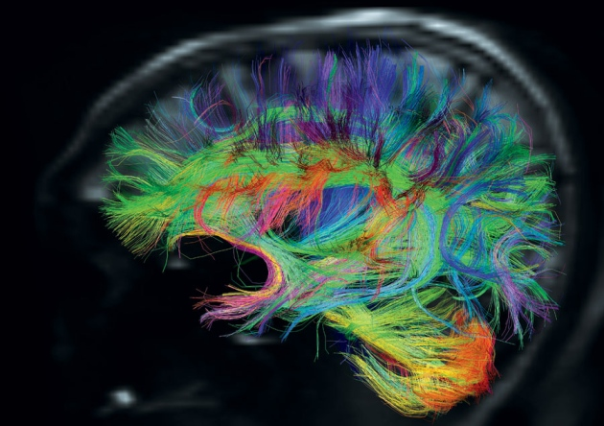
Dataset: HCP 2020
Measurement: task-fMRI
Task: Language (story-math-cue)
Parcels: 360
Subjects: 339
Notes:
I’m going to finish by saying which are math and story tasks

Slide 4
Methodology:
train_set
1. Choosing parcels
matrix
(parcels x subjects)
2. Logistic GLMs
vector
(task type)
3. Wilcoxon test
HCP
dataset
parcel_set
identifying 20 most active parcels for each task comparing with cue state
(40 in sum)
comparing results with
a random sample
accuracy
rate
training model on train_set
testing on test_set
test_set
Notes:
I’m going to finish by saying that if we would have high accuracy rate, then math and language processing differ significantly.

Slide 5
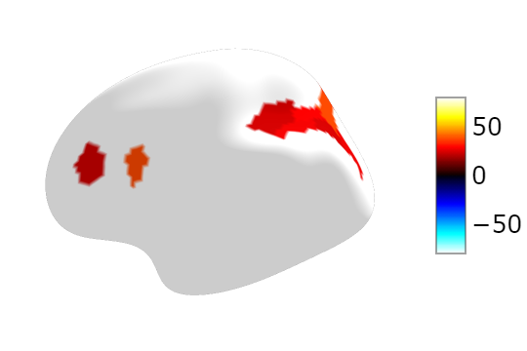
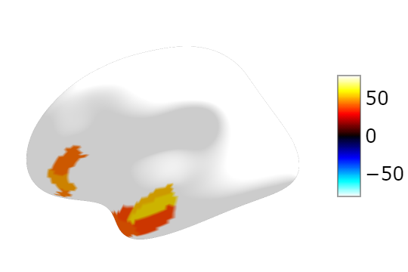
Methodology: finding the parcels
contrast: response_math vs cue
contrast: response_story vs cue
Notes:
Here I will finish by saying that the most active regions do not overlap in math and language

Slide 6
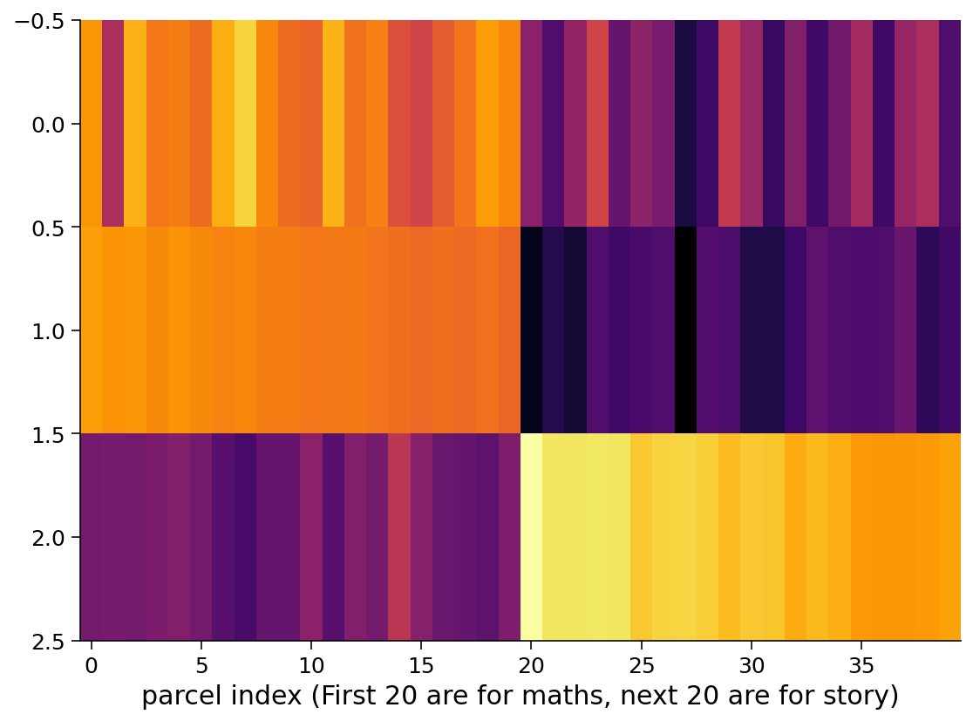
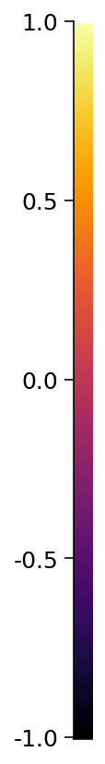
Results:
weight matrix
of GLM
Math parcels
Story Parcels
weights
activity (math)
activity (story)
Note: These values are normalized
Notes:
plotted weight matrix & avg activities as a color map, where is math, where is story || weights are + for math - for story ||
interesting thing to notice: largest activity doesn’t mean largest weight || + math has - story and vice versa
Finish by explaining negative activity for math task in story parcels. ""

Slide 7
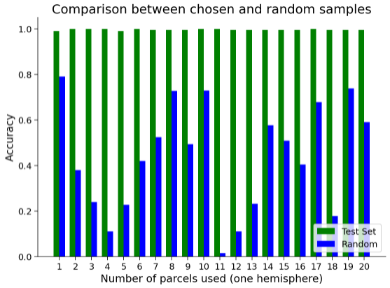
Wilcoxon Test:
random sampling
& parcels
The differences between each two corresponding columns from test set and random set are significant (Wilcoxon test, all p-values < 10^(-12))
Notes:
tested GLM for different # parcels
used some random parcels with our selected parcels
our hypothesis is consistent
we used Wilcoxon test and got p-values <

Slide 8
Discussion:
Math and story problem processing differ drastically in the brain and can be distinguished by the highest activity of only 2 parcels with an accuracy of 97%.
These 2 parcels are superior parietal area (L_MIP) and medial frontoparietal network (aka default mode network, R_10v), and they are significantly better than 2 random parcels in predicting the task type.
The patterns of activity during problem solving are complicated: the parcels with the largest activity during task performance are not the main in task type differentiation. The parcels with the largest weights are rostralmiddlefrontal (R_46) and dorsomedial prefrontal cortex (R_s32).
Notes:
main finding
out of our set of parcels, there were 2 parcels with the highest activity (blue)
surprisingly! they are not the ones that have the highest values in the weight matrix (orange ones)!

Slide 9
Constraints and limitations:
Beta-values: count for fMRI time-lags before running GLM.
Sensory modality of a given task: to what extent does it affect the overlap?
Language limitations: math and story processing in other languages.
Notes:
we did not use beta-values due to the time constraints of the project
In dataset, both math and story tasks were given audibly, maybe patterns of brain activity would differ if they were given in the written form
tasks were conducted with native English speakers, processing patterns might differ in speakers of other languages causing a bigger or smaller overlap between the two brain regions

Slide 10
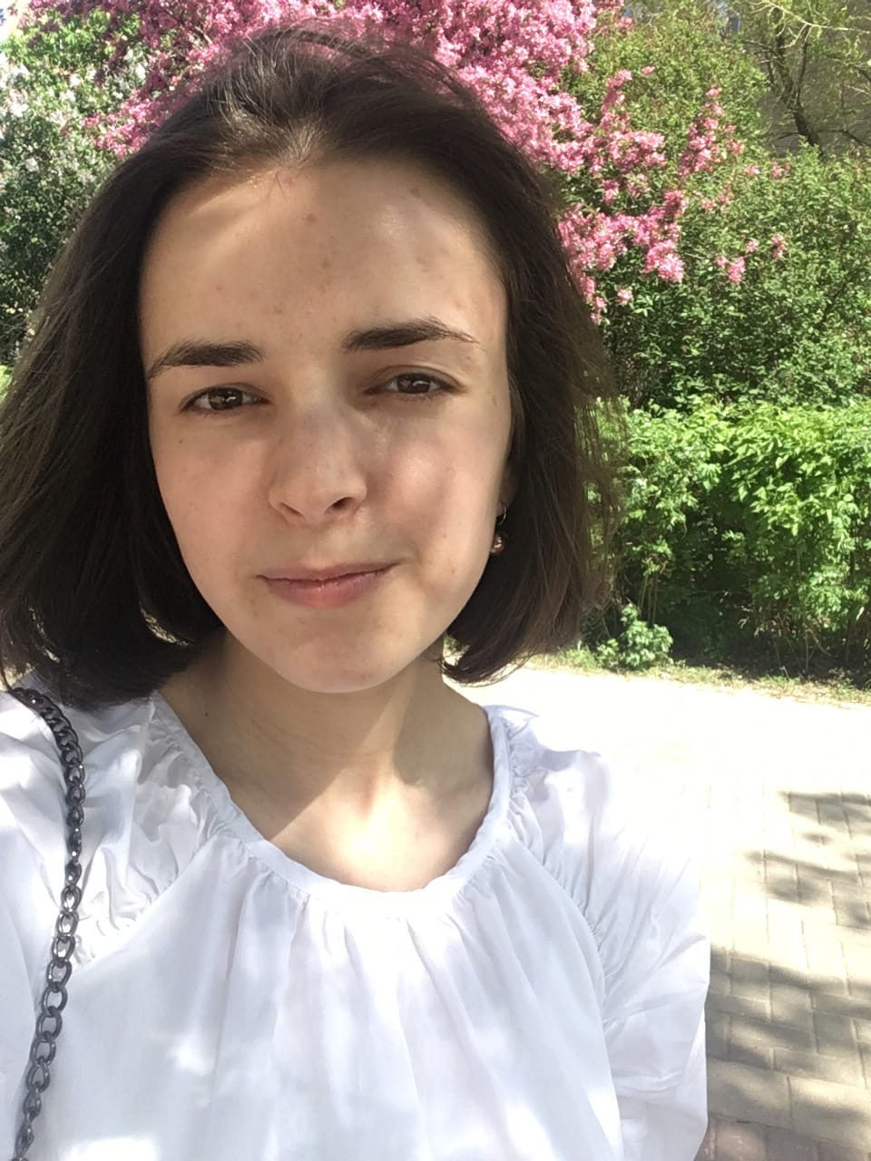
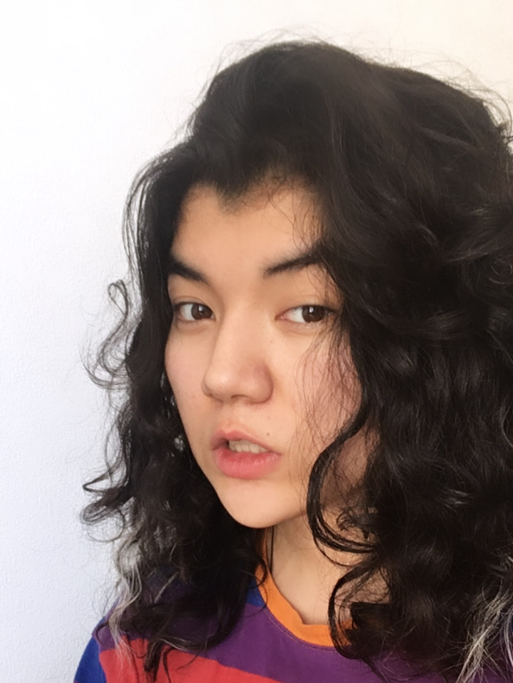
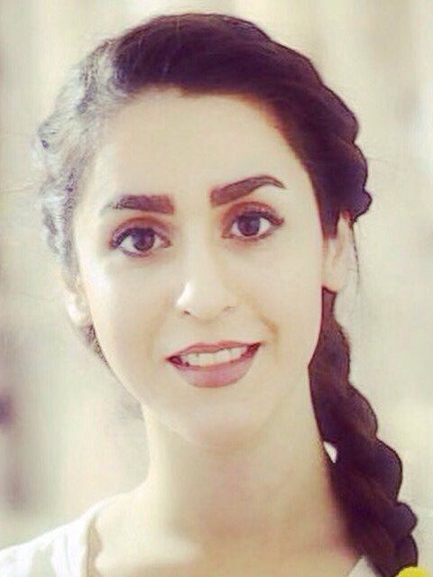

WHO? Porc & Pines!
Pod TA: Clara Kuper
Project TA: Hamed Karimi
Project Mentor: Haiyang Jin
Natasha Evdokimova
Deniz
Nazarova
Parisa Navidi
Shivanshu Tyagi
Notes:
Here we are - amazing Porc & Pines!
Big thanks to our amazing mentor Haiyang Jin and TAs Clara and Hamed

Slide 11
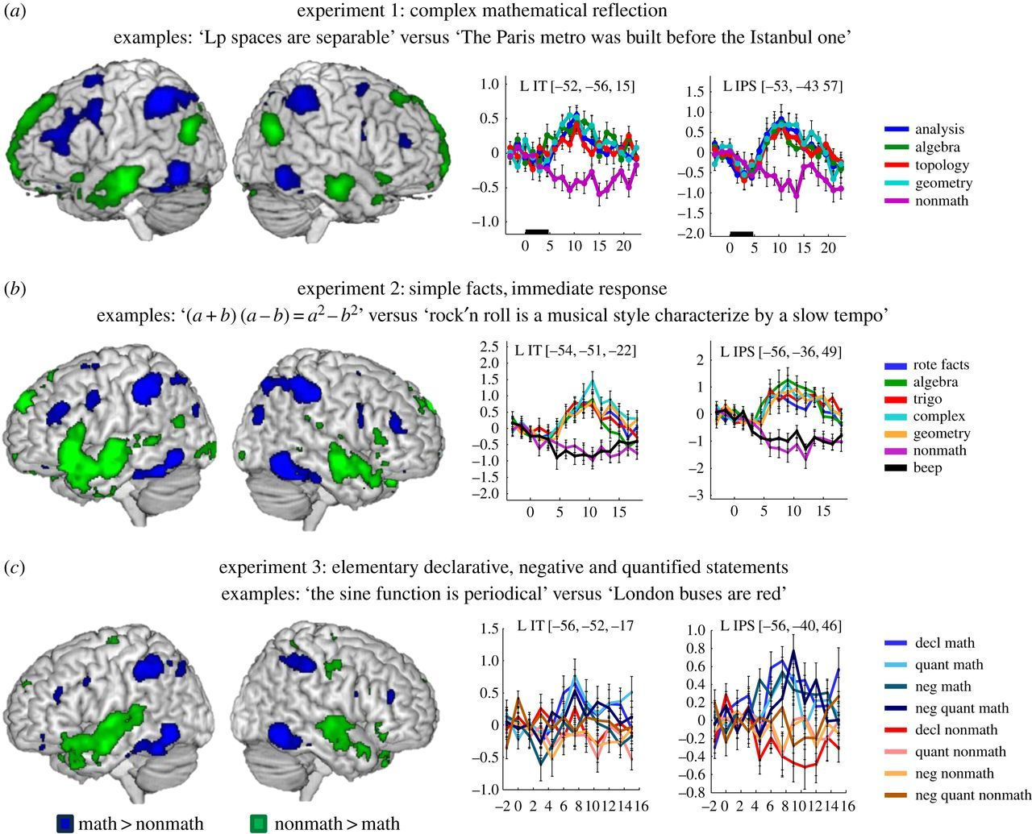
Supplementary

